Slide 1
Chapter 4 - Formulating a Research Problem
authored by Stephanie Fleischer © SAGE publications Ltd 2014

Slide 2
Topics covered
Formulating a research problem in quantitative research
Importance of formulating a research problem
Sources of formulating a research problem
Considerations in selecting a research problem
Steps in formulating a research problem
How to formulate research objectives
The study population
Operational definitions
Formulating a research problem in qualitative research
authored by Stephanie Fleischer © SAGE publications Ltd 2014

Slide 3
Importance of formulating a research problem
First and most important step
Quality and relevance of the research relies on it
Key to formulating the idea of what needs to be investigated
Determines the methodology and design of the project:
Descriptive and qualitative
Correlational and quantitative
The clearer the research question, the easier the next steps
authored by Stephanie Fleischer © SAGE publications Ltd 2014

Slide 4
Sources of research problems
Look closely in your academic field or discipline
Use four Ps:
People
Problems
Programmes
Phenomena
Apply to qualitative and quantitative research
authored by Stephanie Fleischer © SAGE publications Ltd 2014

Slide 5
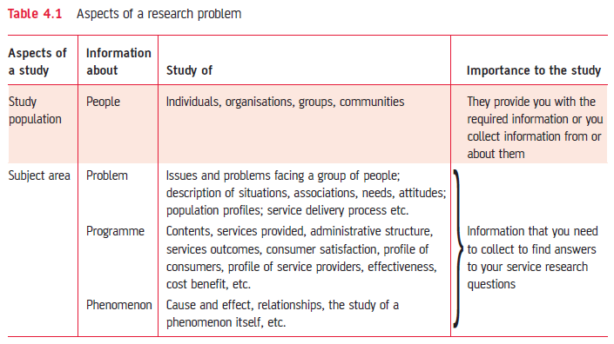
Table 4.1 Aspects of the research problem
authored by Stephanie Fleischer © SAGE publications Ltd 2014

Slide 6
Considerations in selecting a research problem
Interest
Magnitude
Measurement of concepts
Level of expertise
Relevance
Availability of data
Ethical issues
authored by Stephanie Fleischer © SAGE publications Ltd 2014

Slide 7
Steps in formulating a research problem
Step 1: Identify the main subject area
Step 2: Dissect into sub-areas
Step 3: Select sub-areas of most interest
Step 4: Raise research questions
Step 5: Formulate objectives
Step 6: Assess objectives
Step 7: Double-check
authored by Stephanie Fleischer © SAGE publications Ltd 2014

Slide 8
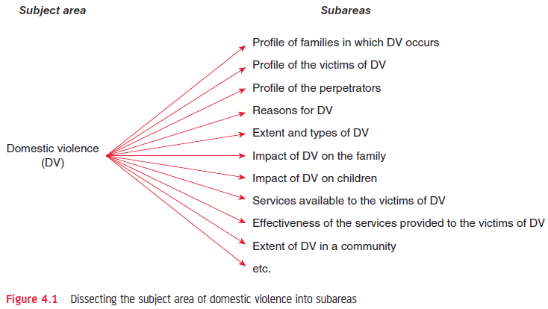
Figure 4.1 Dissecting the subject area of domestic violence into sub- areas
authored by Stephanie Fleischer © SAGE publications Ltd 2014

Slide 9
How to formulate research objectives
Goals that inform what will be achieved
Main objective – overall statement
Describing the main focus
Sub-objectives – specific aspects
Clear and unambiguous wording
Numerically listed
Each contains one aspect
Starts with action word: ‘to find out’, ‘to explore’
authored by Stephanie Fleischer © SAGE publications Ltd 2014

Slide 10
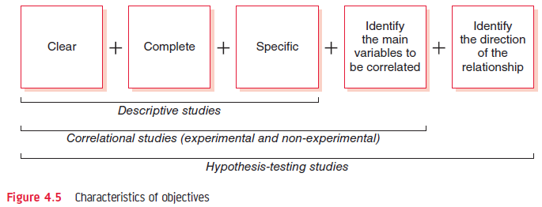
Figure 4.5 Characteristics of objectives
authored by Stephanie Fleischer © SAGE publications Ltd 2014

Slide 11
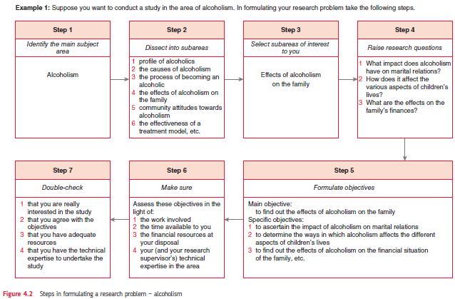
Figure 4.2 Steps in formulating a research problem - alcoholism
authored by Stephanie Fleischer © SAGE publications Ltd 2014

Slide 12
The study population
Second important aspect to the research
Who constitutes the study population?
Select appropriate participants from the study population
Definition may need to be narrowed down
Be as specific as possible
authored by Stephanie Fleischer © SAGE publications Ltd 2014

Slide 13
Establishing operational definitions
Explain working definitions specific to study
Define specific terms, meanings to concepts used
These may differ to dictionary or legal definitions
Avoids ambiguity and confusion
Develops a framework for the study
authored by Stephanie Fleischer © SAGE publications Ltd 2014

Slide 14
Formulating a research problem in qualitative research
Different to quantitative research which is specific, narrow and the framework confines the research (tests hypotheses)
Qualitative research is flexible, open, freedom to include new ideas at a later stage:
Research problem can be reformulated
Inductive reasoning
Flexible conceptual framework to increase depth and richness of data
authored by Stephanie Fleischer © SAGE publications Ltd 2014

